Slide 1


PYTHON MINI PROJECT
TOPIC- Rock, Paper And Scissors
By:
Kushal Karelia (16010520080) Atharva Srivastava (16010520086) Raj Bornak (16010520082)

Slide 2
Problem Statement:
Using the appropriate rules given, make a game of rock, paper and scissors in python which is best of 5 and user can retry after his game is finished.

Slide 3
System Architecture:
Each player(user and computer) selects an action and then a winner is determined. In this the computers choice is hidden from the user so the user cannot cheat in any way and the computer choses a random choice. The two players go head to head in a game of best of 5 and a winner is decided if any one of the player wins 3 games.
Here’s a flowchart that describes how to play games repeatedly until the user decides to stop:
Get user input
Computer generates a random choice
Determine the winner using the logic from the game rules
Play again:
Yes/No
End
Start

Slide 4
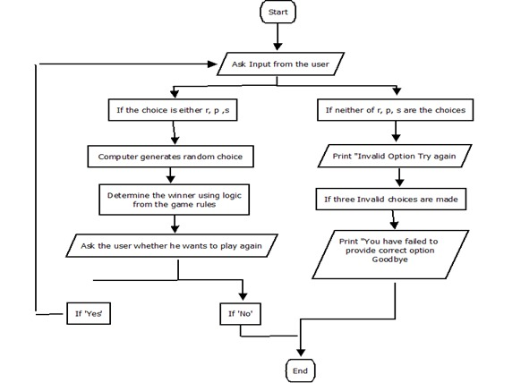
Detailed Flowchart:

Slide 5
Features of system:
First we import random, which is the random module. This helps us generate the random computer moves needed.
We import math which is the math module. This helps us in mathematically setting the game to best of 5.
We import sys which is the sys module. This helps us in exiting the program after 3 attempts are over for the user to put the correct input.
There is a list of moves from which the user and computer can select.
We have used basic if statement, if-else statement, if-elif-else statement, basic while and for loops.

Slide 6
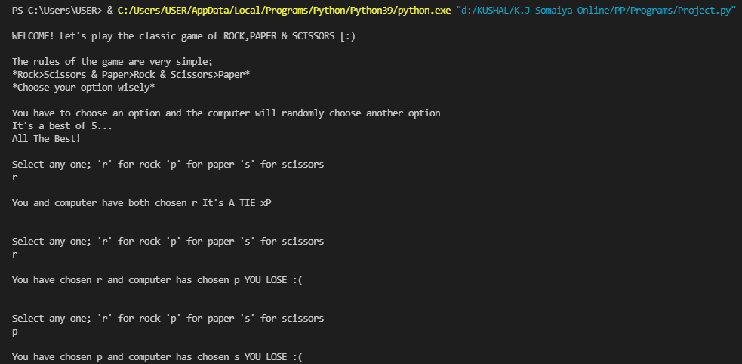
Results:

Slide 7
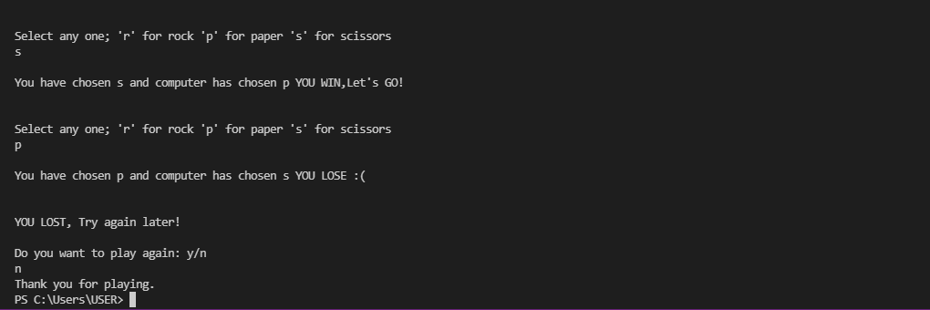

Slide 8
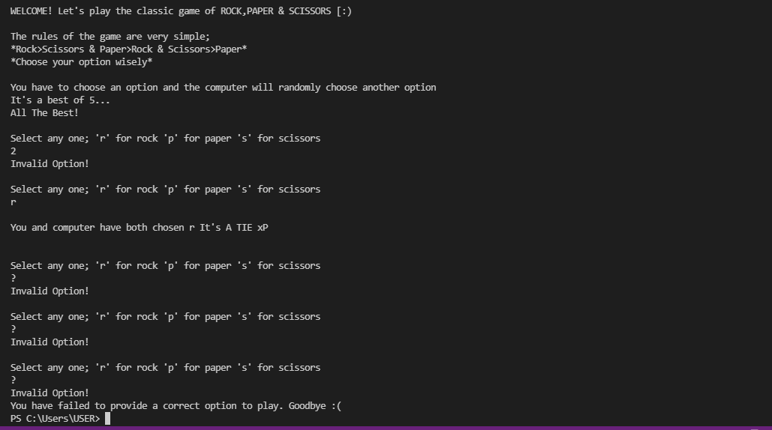
Output when user puts 3 invalid inputs in a row:

Slide 9
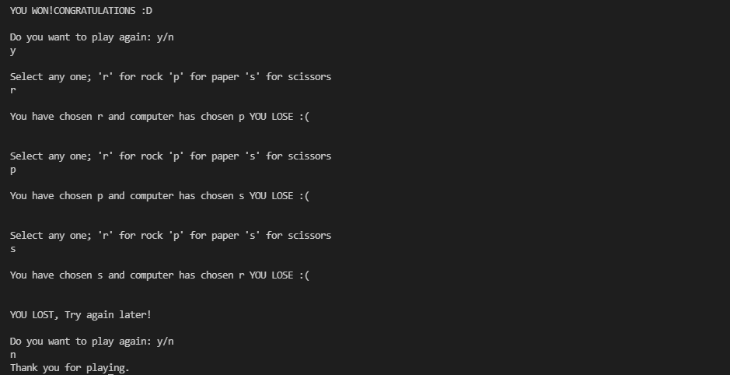
Output when users want to play again:

Slide 10
Conclusion:
We have completed our objective and we have successfully written the rock, paper, scissors program with proper outputs.
Github Link:
https://github.com/kushalk23/rock-paper-scissors
References:
https://www.youtube.com/watch?v=xRlN8CFJwAM
https://realpython.com/python-rock-paper-scissors/
https://www.youtube.com/watch?v=3ppJt87QPNg&t=14s

